Slide 1

CARE≡FLOW
A Centralized Patient-Centric Application for Digital Prescriptions and
Healthcare Management
Team Members
B.B. SABARISAN-24619149
S. SANTHOSH-24619152
S.H. ABIJEETH-24619101
Project Guide
Ms. Benasir Begam.F M.E, (Ph.D)
Batch No: 17
Final review

Slide 2

Abstract
CareFlow is a centralized, patient-centric healthcare application designed to manage digital prescriptions and essential healthcare information in one secure platform.
The system connects patients, doctors and healthcare administrators through a unified workflow. Doctors can create and update digital prescriptions, while patients can view prescription history, medication details and related records without depending on paper documents.
By keeping prescription data organized in a single digital environment, CareFlow aims to reduce prescription loss, improve accessibility, support continuity of care and provide a clearer healthcare-management experience.
The proposed solution focuses on usability, role-based access, secure data handling and scalable digital healthcare management.

Slide 3

PROBLEM STATEMENT
Physical prescriptions can be misplaced, damaged or difficult to retrieve during later consultations.
Patient information may be spread across different hospitals, clinics, files and communication channels
Patients may not have quick access to previous prescriptions, medication instructions or healthcare history
Repeated manual entry and unclear handwriting can increase the possibility of prescription or record errors
Doctors and patients need a common digital space for prescription updates and healthcare information.

Slide 4

OBJECTIVES
Develop a centralized application for storing, viewing and managing digital prescriptions.
Provide separate, role-based access for patients, doctors and administrators.
Allow doctors to create clear digital prescriptions with medicine name, dosage, duration and instructions
Enable patients to view prescription history and access
healthcare information from one place.
Reduce dependence on paper records and minimize problems caused by lost or unreadable prescriptions

Slide 5
LITERATURE SURVEY
No. | Author & Year | Paper / Method | Methodology | Limitation | Our Contribution
1 | Kruse et al.&2015 | E-Prescribing adoption and errors | Studied e-prescribing and errors | Adoption and workflow issues. | Digital prescription management.
2 | Halamka & cerrato,2018 | Patient-centric digital health | Focused on patient-centric digital health. | Information remains fragmented. | Centralized patient information.
3 | Marques et al & 2020 | Blockchain & IoT in Healthcare | Used Blockchain and IoT for healthcare. | Complex and costly infrastructure. | Simple centralized architecture.
4 | Jah et al & 2022 | Telemedicine & Digital Rx post-COVID | Studied telemedicine and digital prescriptions. | Requires secure data sharing. | Easy digital prescription access.

Slide 6
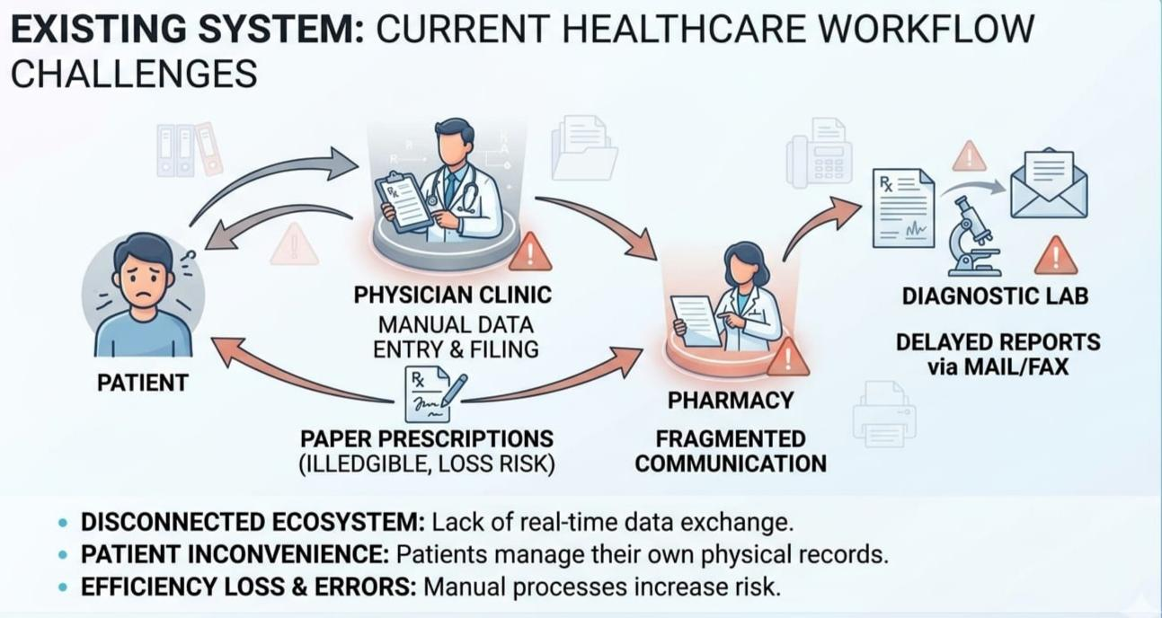

Slide 7
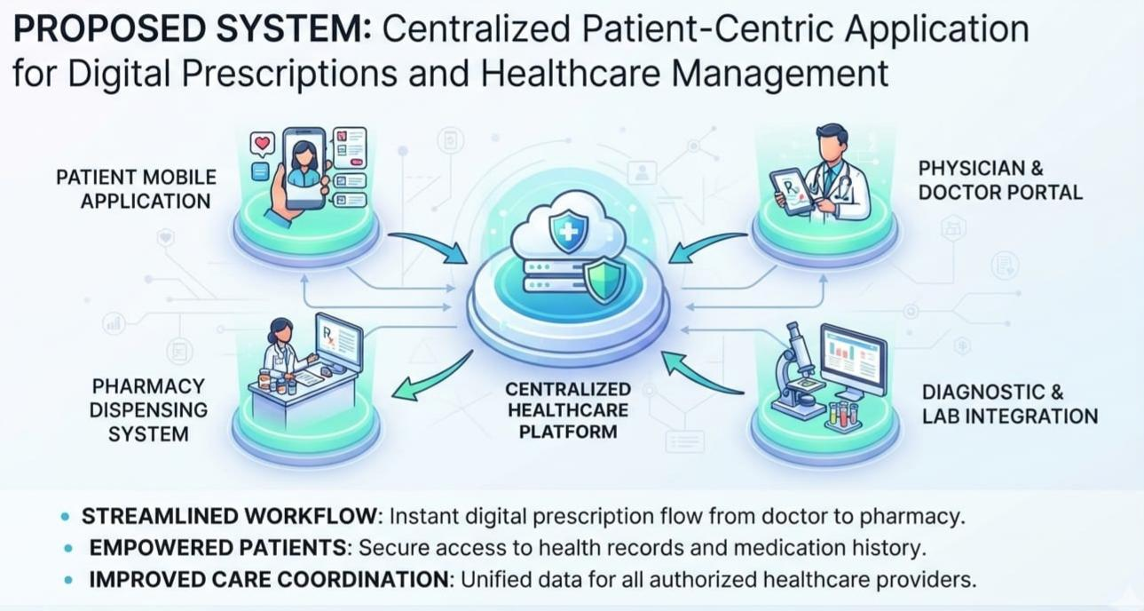

Slide 8

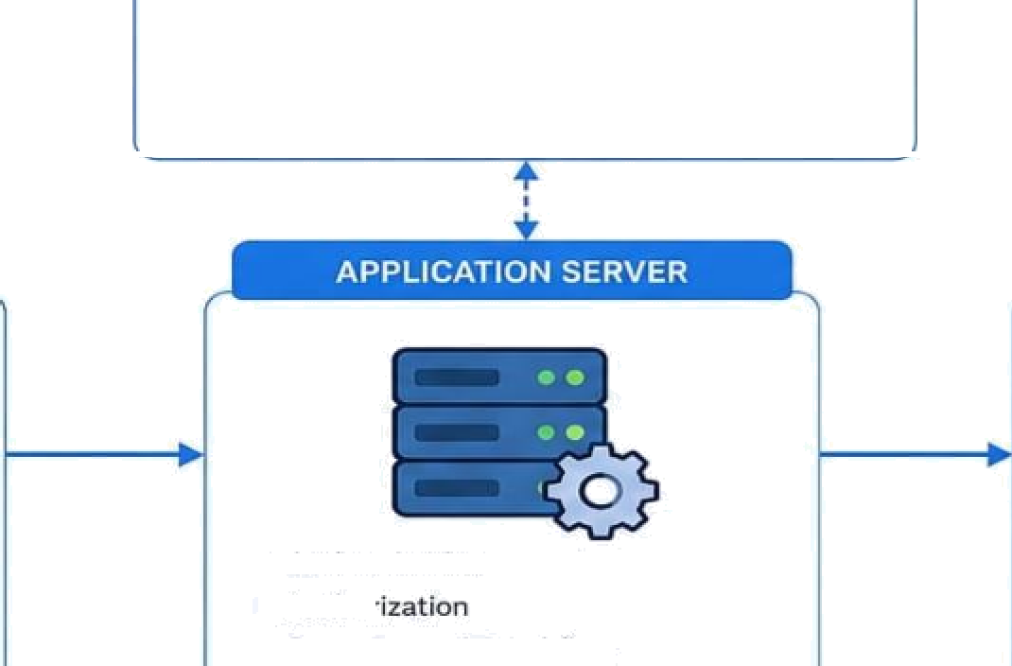



















SYSTEM ARCHITECTURE
'
Careflow follows a 3-tier architecture with secure rote-based access, centralized data management,
and modular application services.
AUTHENTICATIONI SERVICE
Login / Register
Role-based Access Control [RBAC)
Token Management
PATIENT
Login
View prescriptione
History
Health details
FRONT—E ND / UI
DATA Ø ASE ’
OOCTOR
Login
Patient looLup
Creatq / update prescription
Prescriptions
History
Audit Logs
Web / Mobile Interface
Role-based dashboards
Responsive Design
Authenticahon
Author
Prescription & Workflow I • APIs
ADMIN
User management
Syatem monitoring
REPQL C T ON
ERVICES IN R
UC
Data Ftow
NOTIFICATION
SERVICE
t
BACKUP & RECOVERY
EXTERNAL SERVICES
8ECURFTY LAYER
Eme\l / SMS
Alerts & Updates
I • Prescription Files t
Reports / Documents
Activity Logs
, • System Logs
, • Data Backup
: • Disaster Recovery
Pharmacy APU
' • Payment Gateway
Control
DATA FLOW SU¥1MARY
User Authentication
Role-based
Dashboard
Application Services
Central Database
Secure Data Retrieval / Update

Slide 9
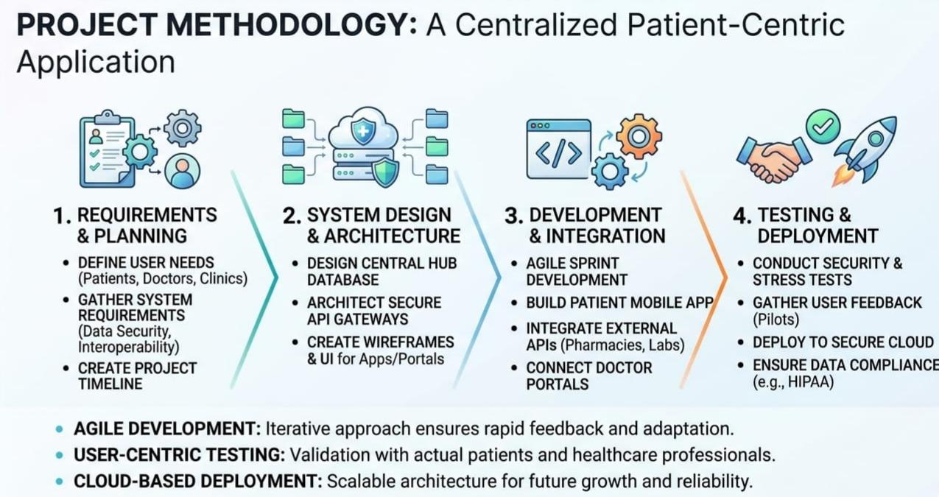

Slide 10
PROJECT TECHNOLOGY
SOFTWARE:
Front-end: HTML, CSS, JavaScript / mobile UI framework
Back-end: Python / Java / Node.js based API layer
Database: MySQL / PostgreSQL
Development: VS Code or equivalent IDE
Version control: Git
API testing: Postman
Deployment: Cloud or local server environment
HARDWARE:
Processor: Intel Core i5 / AMD Ryzen 5 or above
RAM: 8 GB minimum; 1G GB recommended
Storage: 20 GB+ free SSD space
Display: 13GG × 7G8 or higher
Internet: Required for cloud/database access
Optional server/GPU resources depending on deployment scale

Slide 11
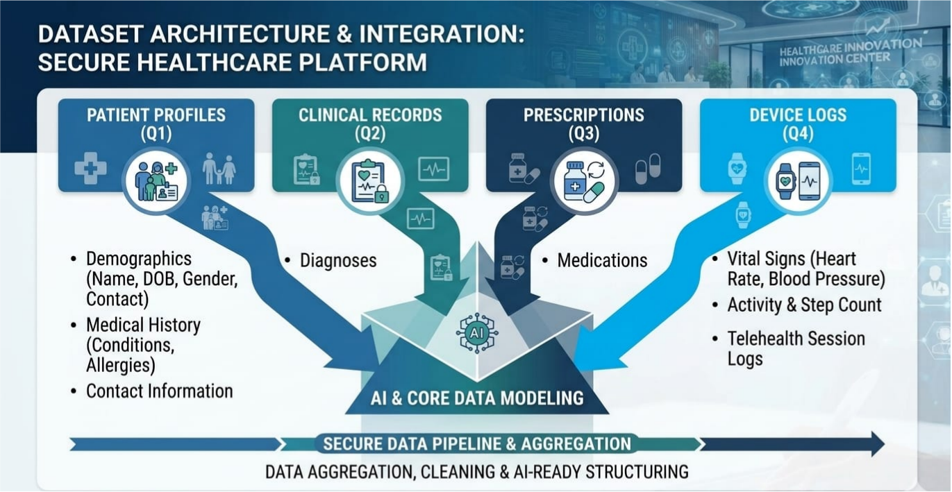

Slide 12
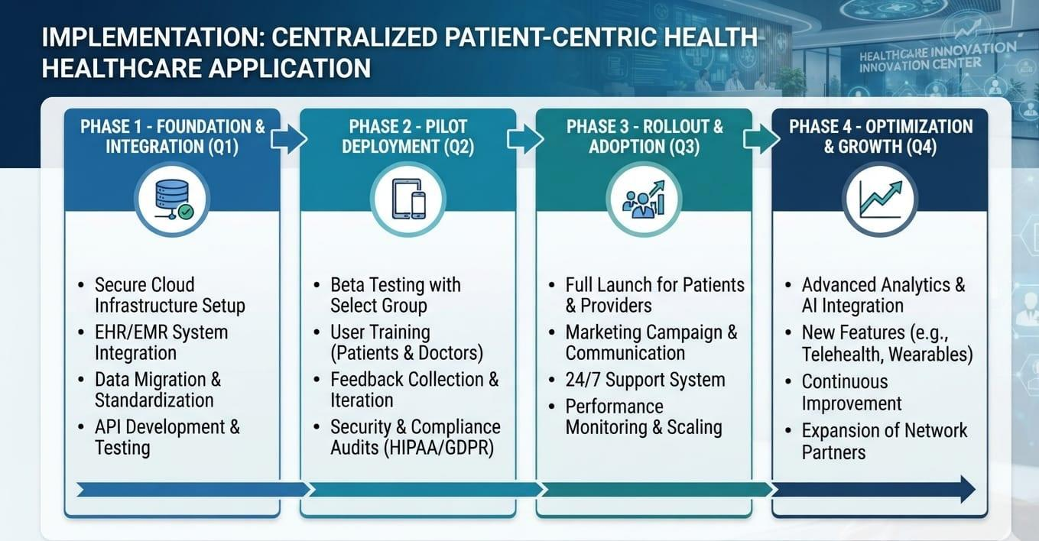

Slide 13
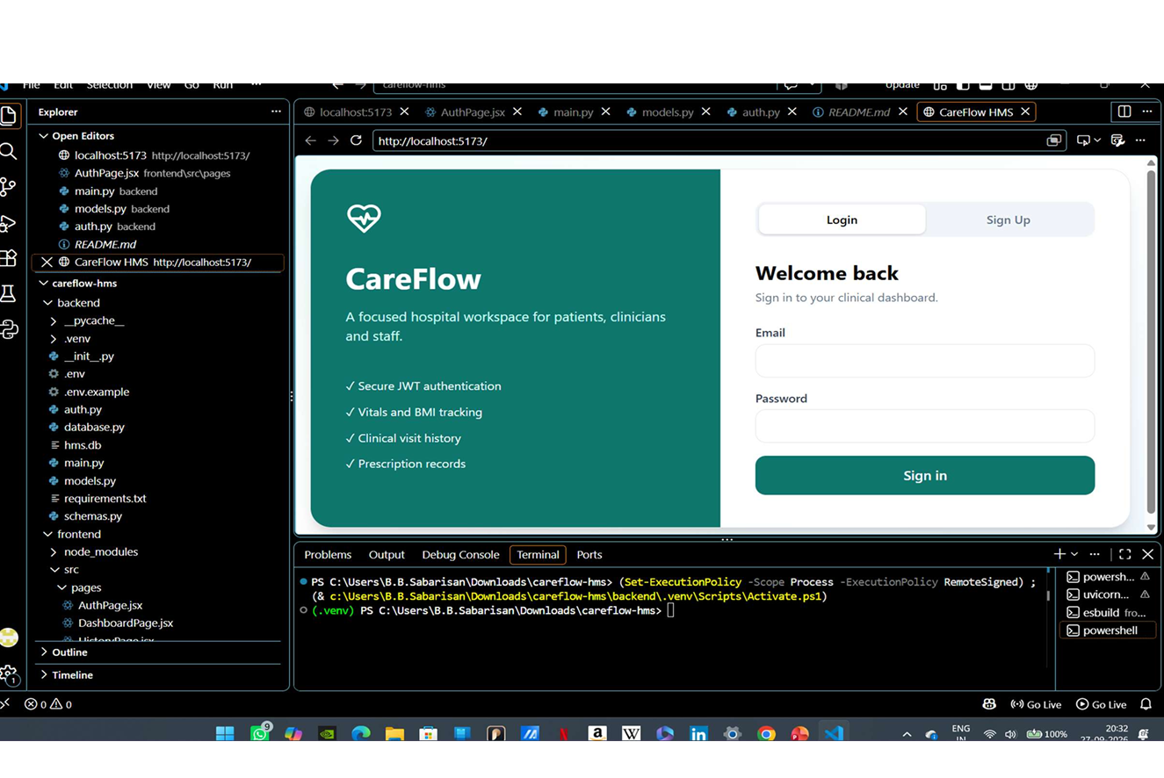

Slide 14
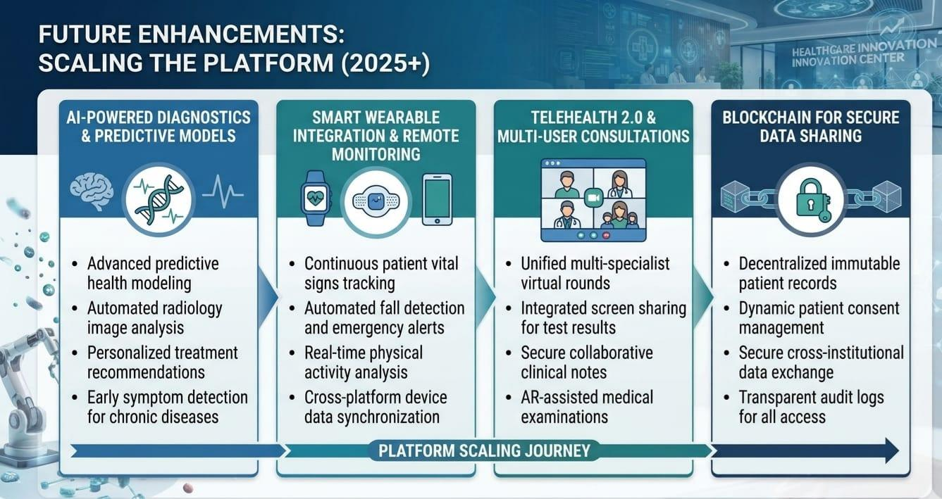

Slide 15
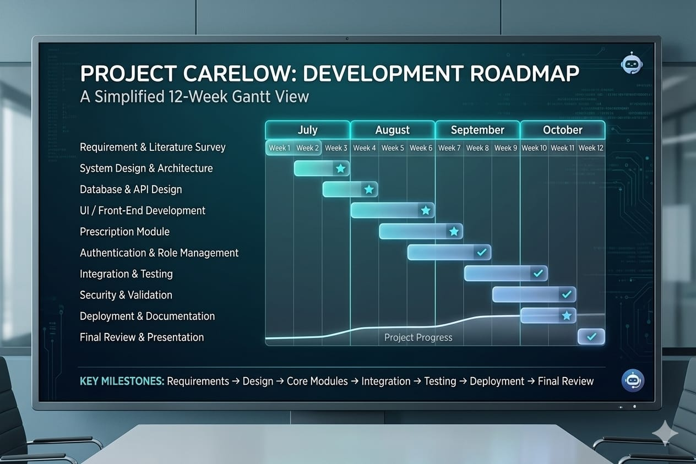

Slide 16
CONCLUSION
Careflow provides a centralized, patient-centric solution for managing digital prescriptions and essential healthcare information. It reduces dependence on paper-based records by organizing prescriptions and patient history in one secure platform. The system improves accessibility, supports continuity of care, and makes healthcare information easier to manage for authorized users. Future enhancements can include stronger security, healthcare-provider integration, notifications, analytics, and interoperability with other healthcare systems.

Slide 17
THANK YOU

